Slide 1


Scholarship & Funding Opportunities in Turkey
for International Academics and Students

Slide 2
Scholarship & Funding Opportunities in Turkey for International Academics and Students
Scholarship & Financial Funds
1- Education
2- Scientific Research
3- Multi-latarel Cooperation and Partnerships

Slide 3
1- Education (Academic Scholarship Programmes)
Associate Degree
Undergraduate
Graduate (Master-Phd-Post Doctoral)
(Türkiye Scholarship, Study in Turkey, Exchange Programmes)

Slide 4


Slide 5
Balkans Scholarship Program
Balkans Scholarship Program is only for the citizens of following countries: Albania, Bosnia Herzegovina, Bulgaria, Croatia, Montenegro, Kosovo, Republic of Macedonia, Serbia and Greece.

Slide 6
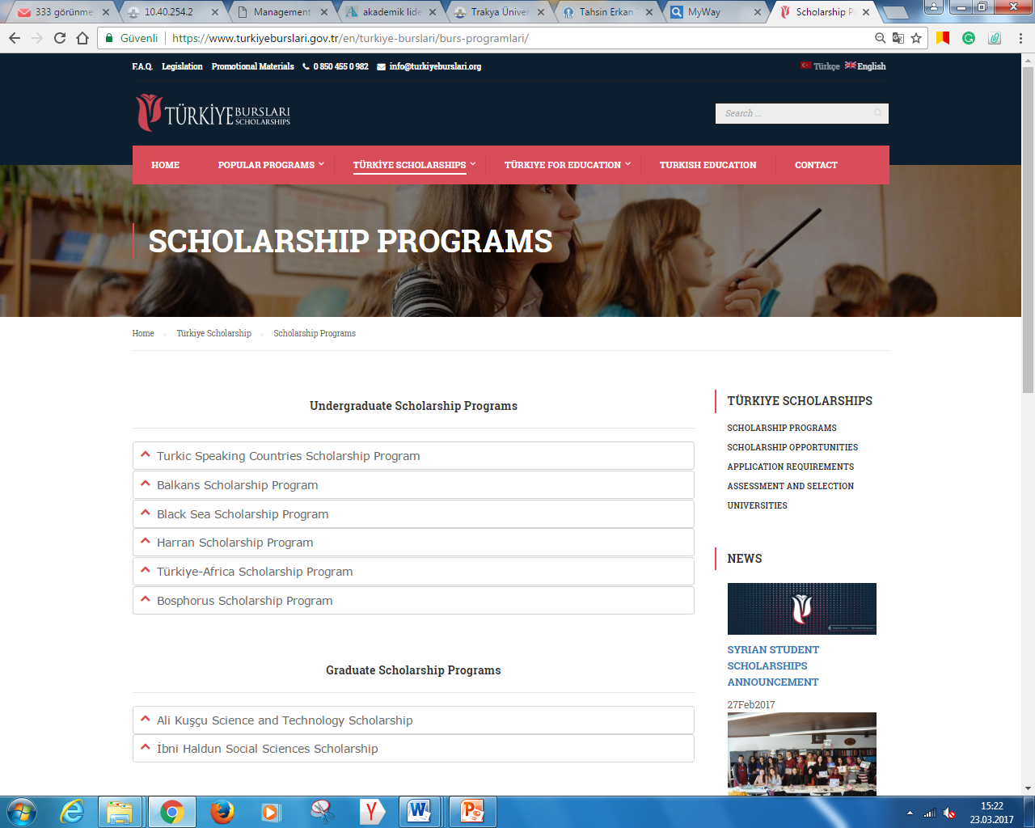

Slide 7
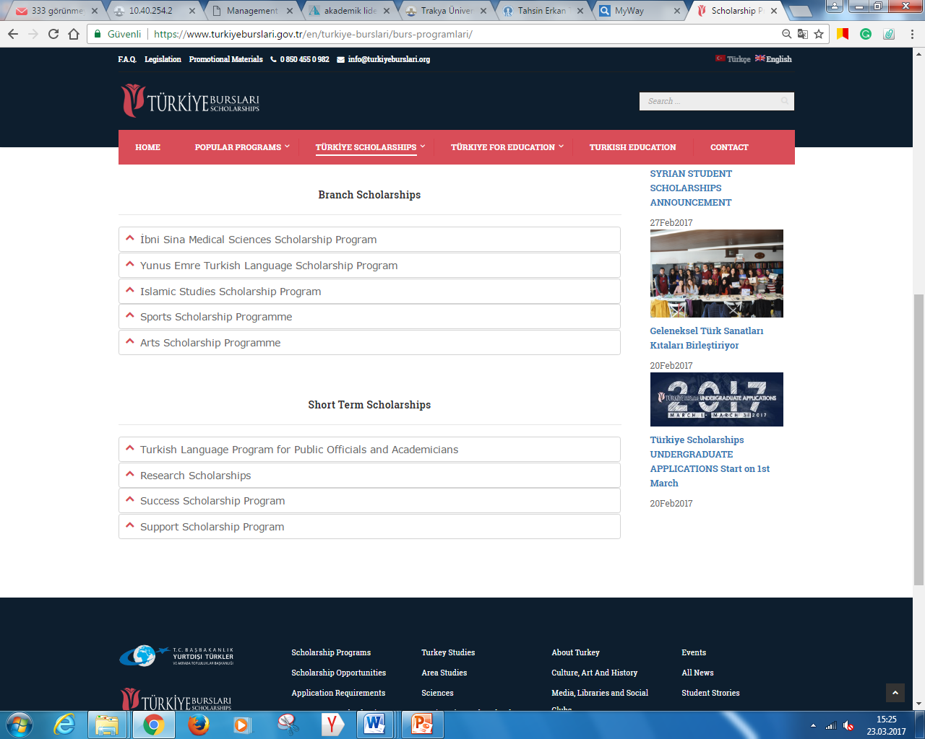

Slide 8
Türkiye Scholarship Programme Total: 67.500
Present: 16.864
Trakya University: 169 ytb_istatistik_eng.mp4

Slide 9
I. Allowance
The monthly allowance allocated according to level of study is as follows:
• Undergraduate Students; 700 TL (200 EURO)
• Master’s Students; 950 TL (260 EURO)
• Ph.D. Students; 1,400 TL (475 EURO)
• Research Scholarships; 3,000 TL (950 EURO)

Slide 10
II. Accommodation
III. Tuition and Fees
IV. Health Expenses
V. Turkish Language Course
VI. Travel Expenses (One-off Flight Ticket)

Slide 11
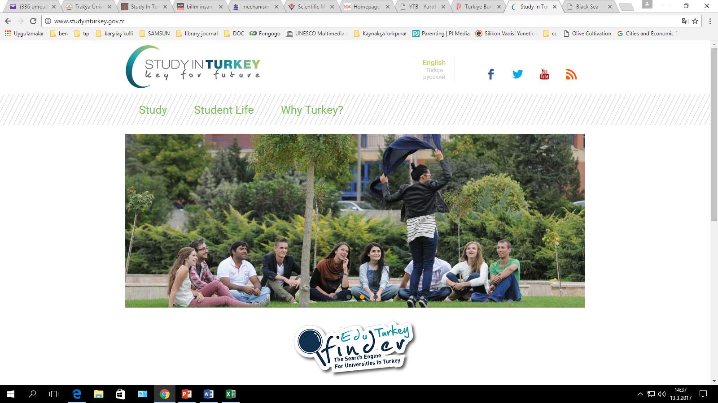
1-
Academic Scholarship Programmes

Slide 12
Study in Turkey
‘’Study in Turkey’’ is designed for foreign students wishing to study in higher education institutions in Turkey.
Students can apply by themselves directly to the university and faculty which they wish to study.

Slide 13
Study in Turkey
Total: 36.000
Trakya University: 2266
Students Coming from Balkans: 1920

Slide 14



Exchange Opportunities
1-
Academic Scholarship Programmes

Slide 15
MEVLANA EXCHANGE PROGRAMME
Programme, offer a wide range of scholarships to assist associate, undergraduate, master’s, and Ph.D students and academicians.

Slide 16
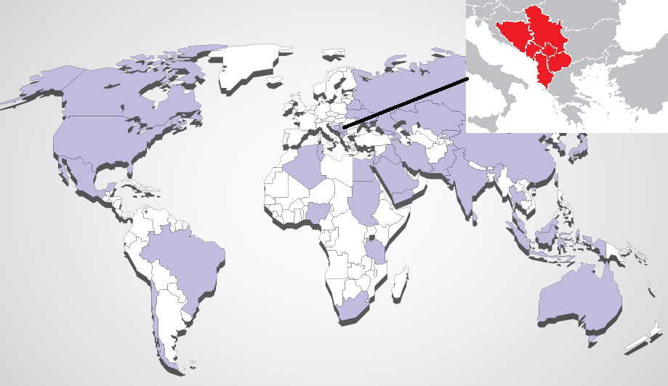
Coordinatorships

Slide 17
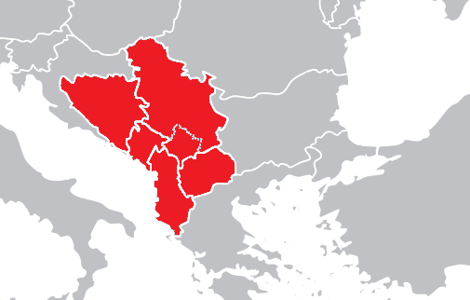
Coordinatorships in Balkans

Slide 18
Incoming Outgoing
(Trakya University) Students: 45 27
(Trakya University) Teaching Staff: 33 36
Turkey Total: 5636

Slide 19
The monthly allowance allocated by Trakya University as follows:
Students: 900TL (250 EURO)
Teaching Staff:
Travel Expenses: max. 2,250 TL (520 EURO)
Allowance for two weeks period: 750 TL (230 EURO)

Slide 20
Programme, offer a wide range of scholarships to assist students and academicians in Turkey.
The international student and academicians can also apply for Farabi Programme while their stay in Turkey.

Slide 21
Yunus Emre Institute, which started to operate in 2009, has more than 40 cultural centres abroad. (in 40 countries)
The centre gives Turkish education and also supports Turkology departments with the cooperation agreements made with different educational institutions in different countries.

Slide 22
The Institute organizes several activities in order to introduce Turkish culture and art; Turkey is represented through national or international events.

Slide 23
Since Saraybosna YEE is the first institute, it makes the most extensive programs and serves as an example to the other institutes.

Slide 24
Cultural Centres
Albania – Shkoder
Albania – Tiran
Bosnia Herzegovina – Fojnica
Bosnia Herzegovina- Mostar
Bosnia Herzegovina – Sarajevo
Croatia – Zagreb
Kosova – Peć
Kosovo - Pristina
Kosovo - Prizren
Macedonia - Skopje
Montenegro - Podgorica
Romania – Bucharest
Romania - Constanța
Serbia - Belgrade

Slide 25
2- Scientific Research
A- International Research Fellowship Programmes
B- International Postdoctoral Resarch Programmes
(Türkiye Scholorship, Mevlana Exchange Programme, TUBİTAK)

Slide 26

2- Opportunities for Scientific Research
A- International Research Fellowship Programmes
B- International Postdoctoral Resarch Programmes

Slide 27

Scientific Support Programmes
2216- International Research Fellowship
2221- Sabbatical Scientist Research Fellowship
Scientific Meetings Grant Programme

Slide 28
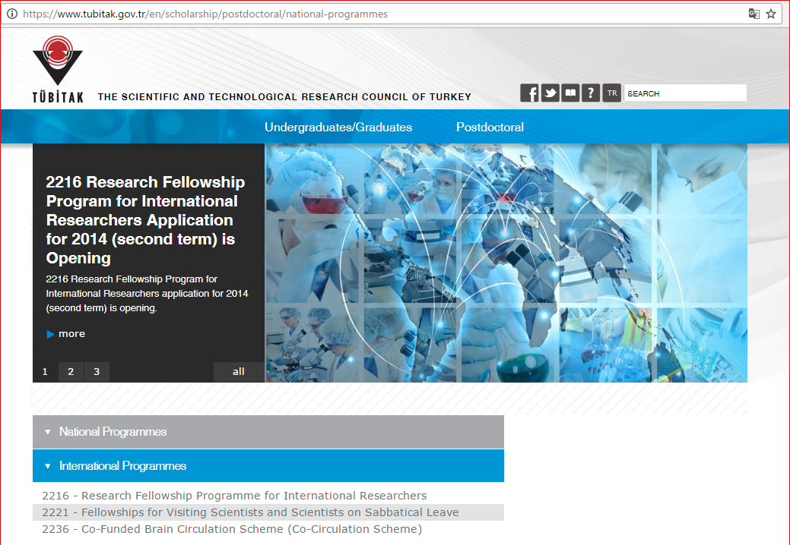

Slide 29
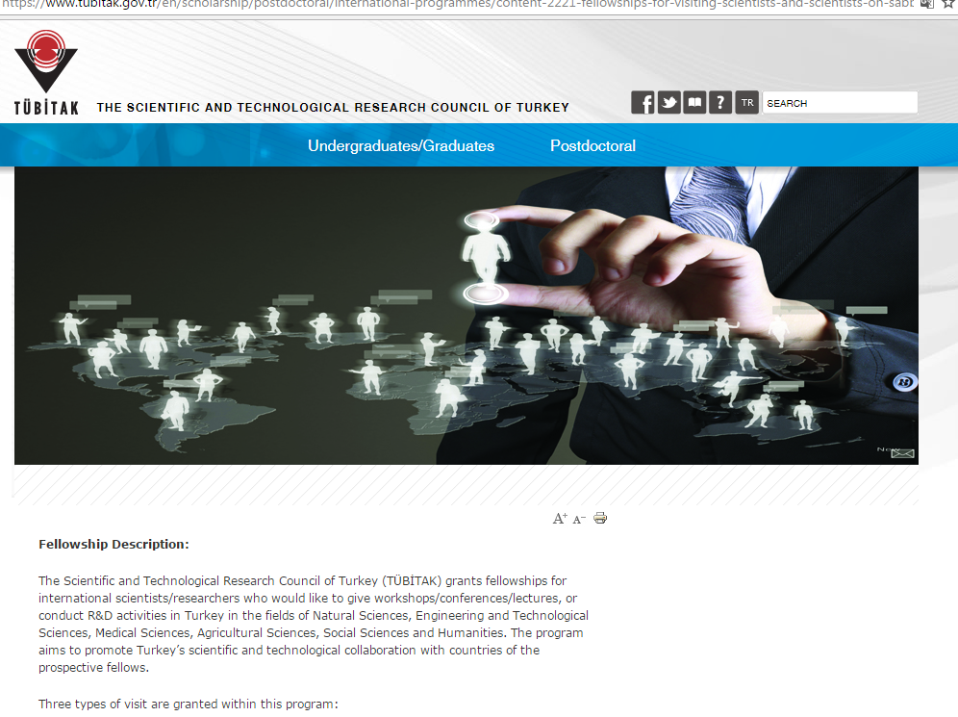

Slide 30

3- Other Support Mechanism for Research Projects
(In the format of Bilaterel and Multi-lateral Cooperation)
Bilatarel Cooperation Programmes
2515- Bilatarel Scientific Programme
2501- Bilatarel Programme (TUBİTAK& Bulgarian Academy of Sciences)
1509 - TÜBİTAK International Industrial R&D Projects Grant Programme

Slide 31
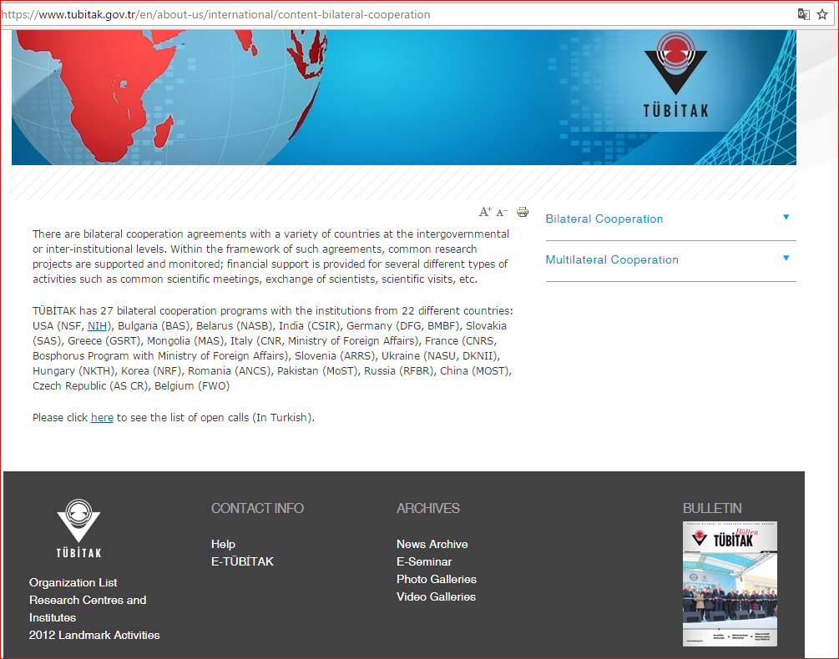

Slide 32
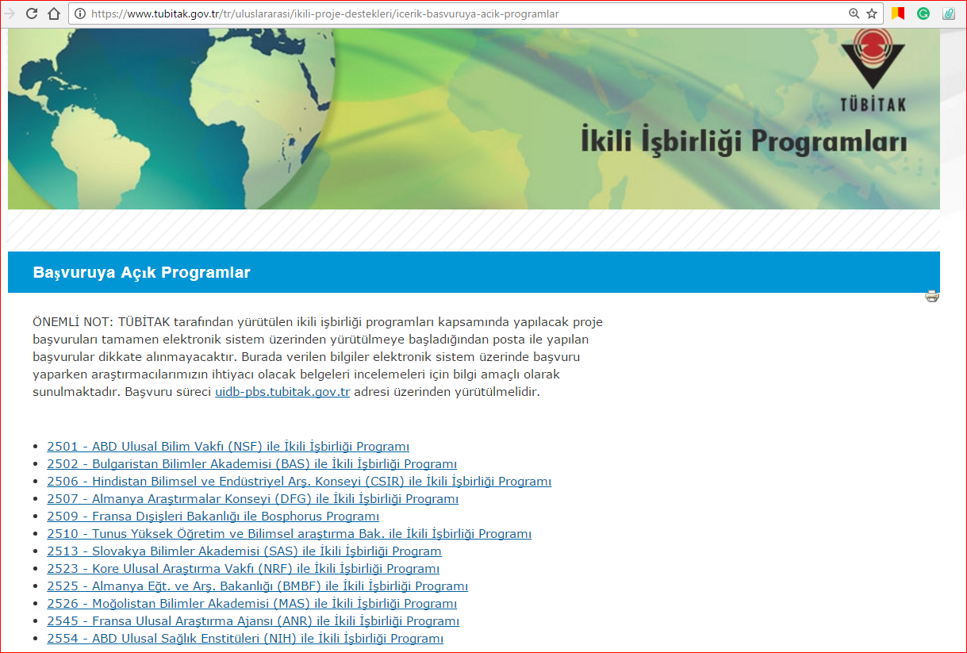

Slide 33
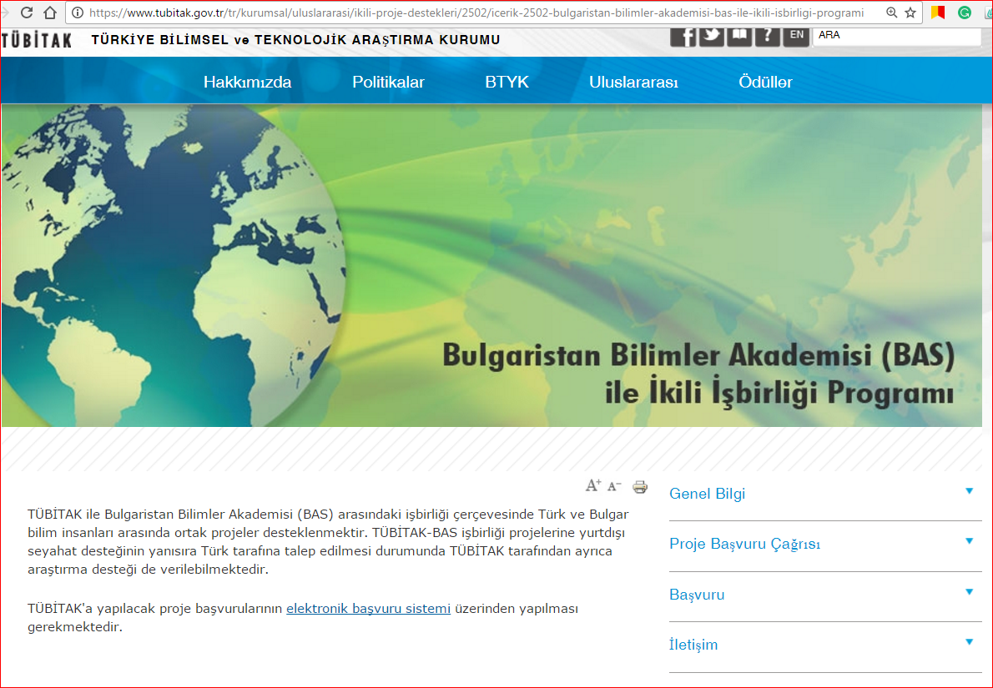

Slide 34
3- Multi-lateral Cooperation Programme
Receiving the external sources
through collaborations and partnerships developed
within the universities in the Balkan Countries and Turkey
via
research centres, institutes, chairs …
(EU, UNESCO, World Bank, UNDP, Black Sea Basin Cross-Border Research Programmes, Governmental Grants, COST , TACSO
etc. )

Slide 35
Our ‘’MISSION in LIFE’’ is to develop multi-latarel cooperation for understanding and analysing our needs and set to research areas where we can gain a mutual benefit !!!

Slide 36
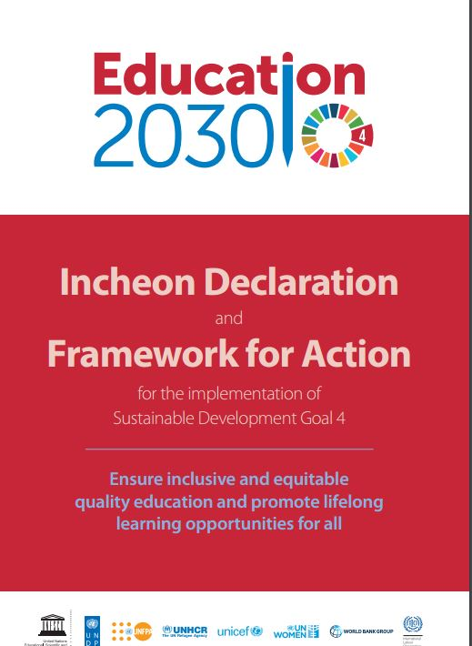
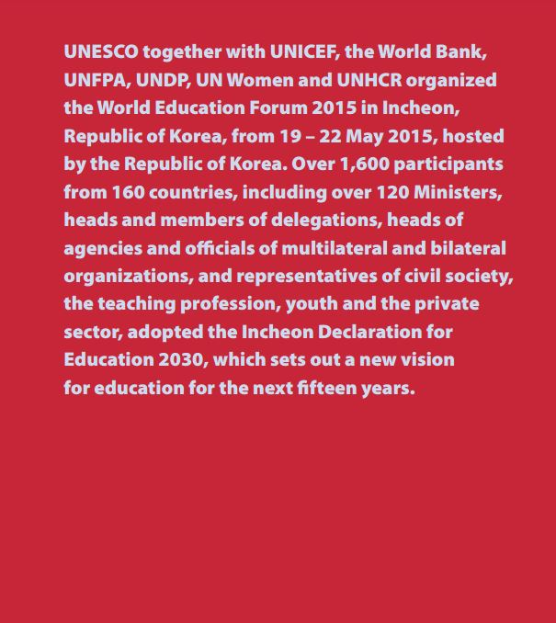


Slide 37


Slide 38
Opportunities for Founding from Public Institutions
(in Turkey)
3- Support Mechanism for Other Research Projects
1. Ministry of Culture and Tourism (Turkey)
2. Presidency for Turks Abroad and Relative Communities (YTATB)
3. Ministry of Youth and Sports:
Youth Projects Support Programme
4. Ministry of Foreign Affairs-Promotion Fund of the Turkish Prime Ministry

Slide 39
Opportunities for Founding from Public Institutions
(in Turkey)
3- Support Mechanism for Other Research Projects
Trakya University organized Balkan Sports Games on May 11th, 2016 which was financed by Ministry of Foreign Affairs-Promotion Fund of the Turkish Prime Ministry. (8 Balkan countries, 15 universities and 450 people (including trainers and athletes) participated the event.

Slide 40

Thank You…

