Slide 1



Future Academic Activities of BUA
Proposals from the otolaryngology example:
20 years’ personal experience
3rd Meeting of Balkan Universities Association
24-25 March 2017, Sofia, Bulgaria
Prof. Cem Uzun, MD
Trakya University, Vice Rector & General Secretary
Balkan Society of ORL-Head Neck Surgery, General Secretary
Trakya Society of ORL-Head Neck Surgery, Board of Directors
Balkan Medical Journal, Editor at Large
European ORL Board, Delegate of Turkey
Edirne-Turkey

Slide 2

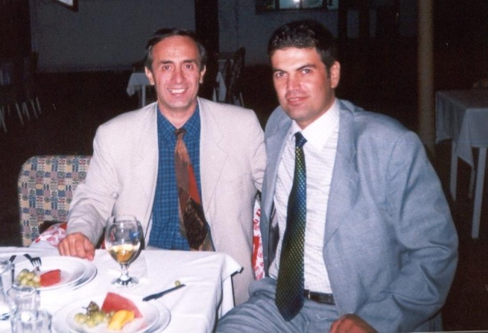
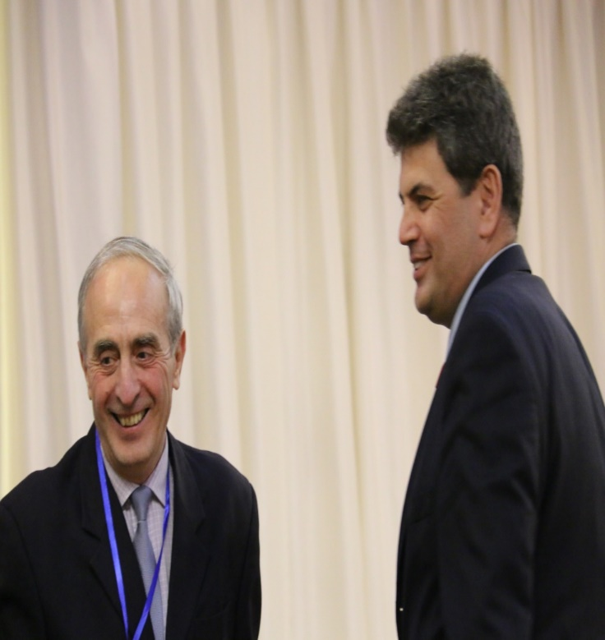
Collaboration between Stara Zagora and Edirne since 1997

Slide 3
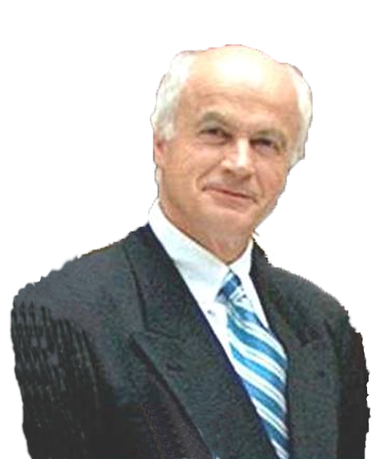
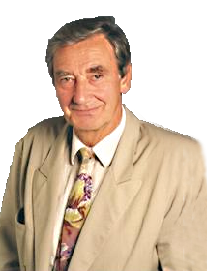
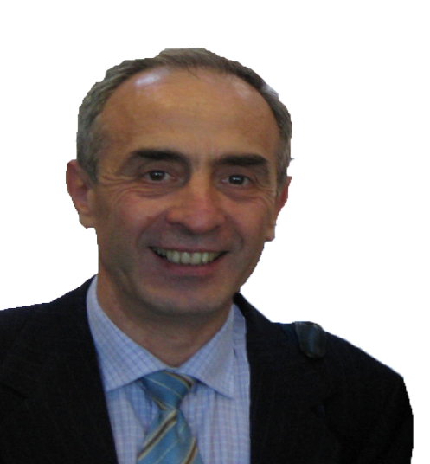
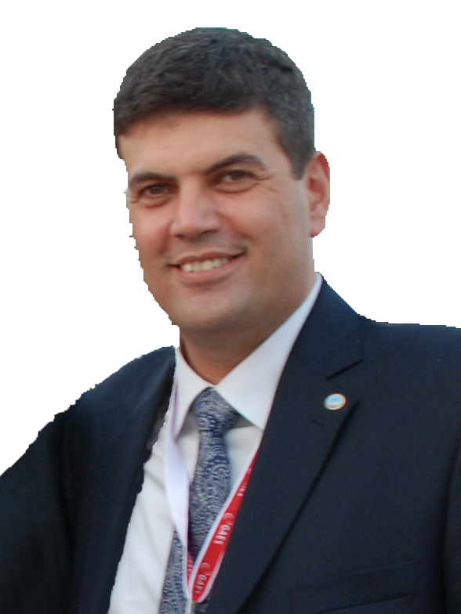
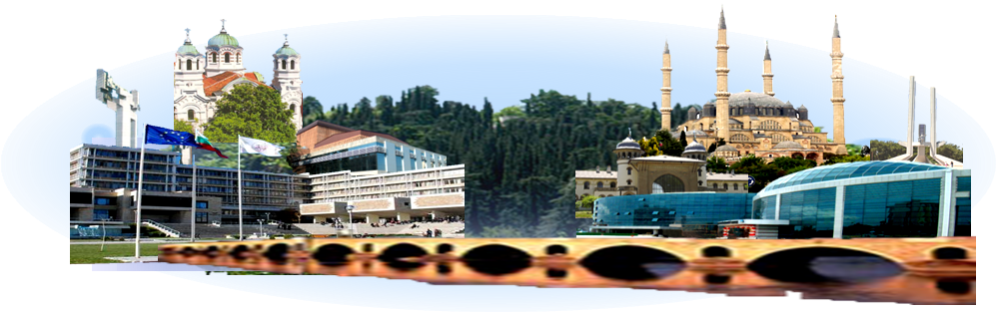
Recent Otology History of Last 15 Years in Region of the Thrace, Balkans
OTOLOGY IN THRACE - TEACHERS
STARA ZAGORA EDIRNE
Prof. Dr, Jacques
Magnan, France
Prof. Dr, Mirko Tos, Denmark
Prof. Dr, Pavel Dimov, Bulgaria
Prof. Dr, Cem Uzun,
Turkey

Slide 4
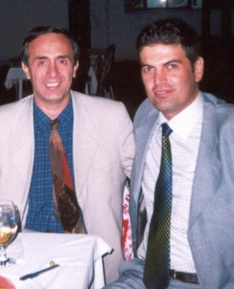
Pavel DIMOV & Cem UZUN
have organized > 30 scientific meetings, tympanoplasty courses, dissection or live surgery courses, congresses in European standards
have attended > 100 scientific meetings in the Balkans as invited lecturers
also at World or European Congresses, or American Academy meetings and represented the Balkans in the world

Slide 5
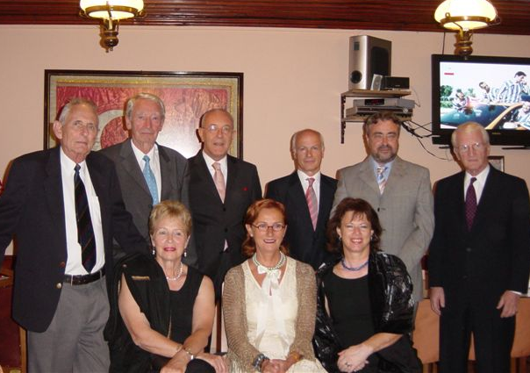
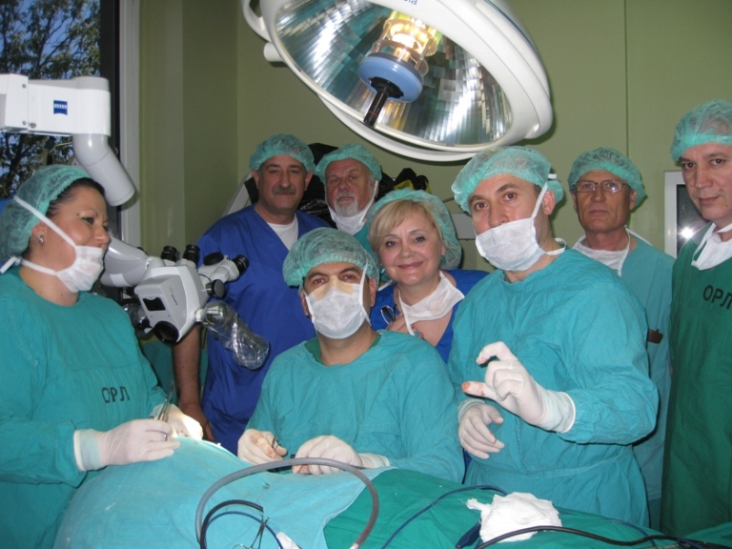
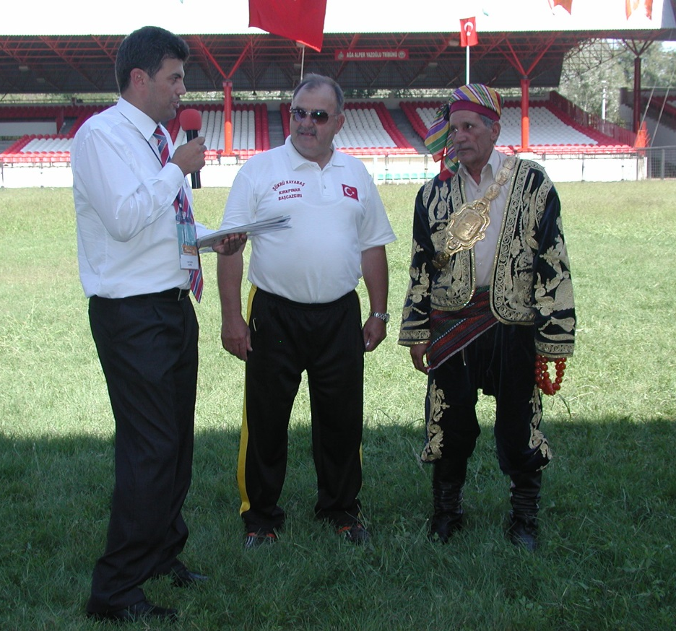
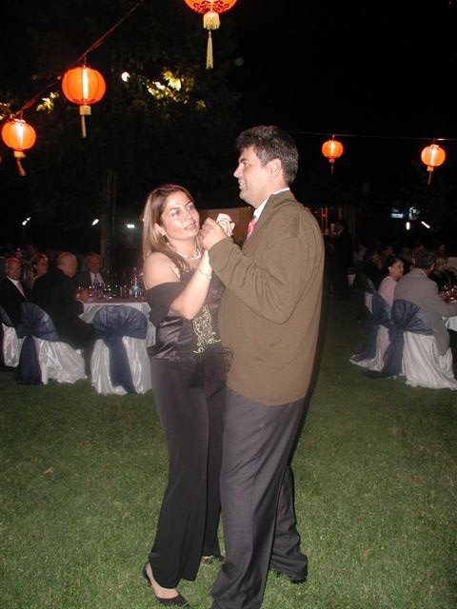
Well admirable scientific
&
social programs

Slide 6

1-st Trakya Days Stara Zagora, May 21-23, 2014
Trakia University Stara Zagora, Bulgaria – Trakya University Edirne, Turkey
Dissemination of
Scientific Collaboration in
Thrace to the Balkans:
the Otolaryngology Example
Pavel Dimov
Center of Otology and Neuro-Otology
Trakia University St. Zagora, Bulgaria
Cem Uzun
Clinic of Otorhinolaryngology, HNS
Trakya University Edirne, Turkey
Dissemination of Scientific Collaboration in Thrace to the Balkans: the Otolaryngology Example
1-st Trakya Days Stara Zagora, May 21-23, 2014 Trakia University Stara Zagora, Bulgaria – Trakya University Edirne, Turkey
Prof. Dr. Pavel Dimov, Prof. Dr. Cem Uzun

Slide 7

Balkan Society of ORL-HNS
Albania
Bosnia & Herzegovina
Bulgaria
Greece
Hungary
Kosova
Montenegro
Rep. of Macedonia
Romania
Serbia
Turkey

Slide 8
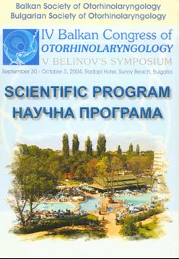
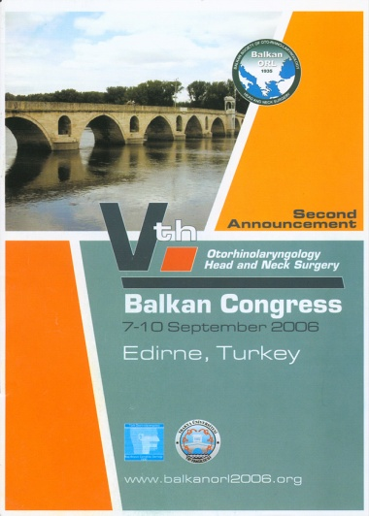
Balkan Congresses of ORL&HNS
1931 Sofia
1933 Bucharest
1935 Society established
1938 Athens
2002 Society reasblished
2004 Burgas
2006 Edirne
2008 Thessaloniki
2010 Nis
2012 Targu Mures
2014 Budva
2016 Tirana
2018 Varna

Slide 9
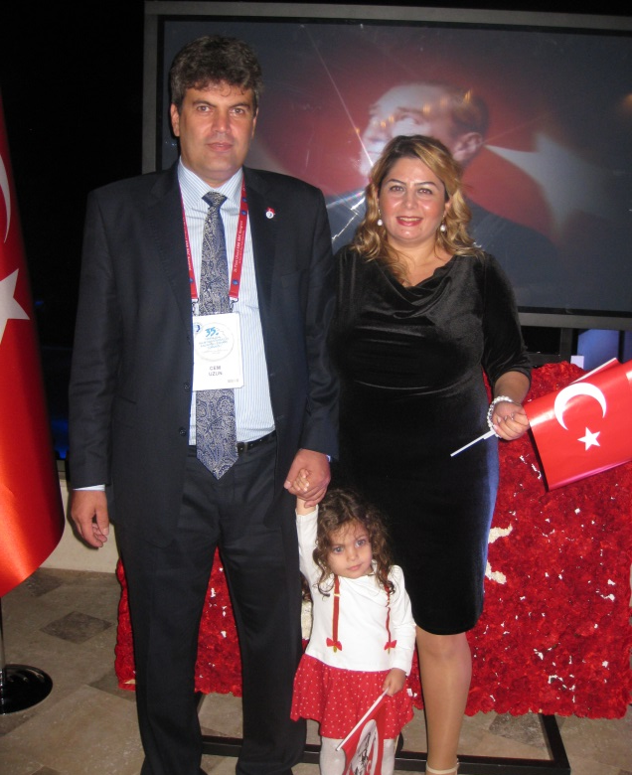
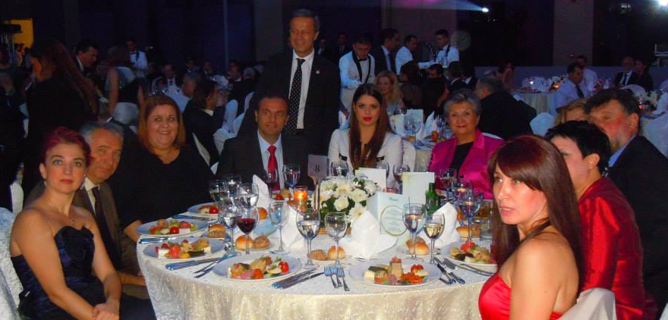
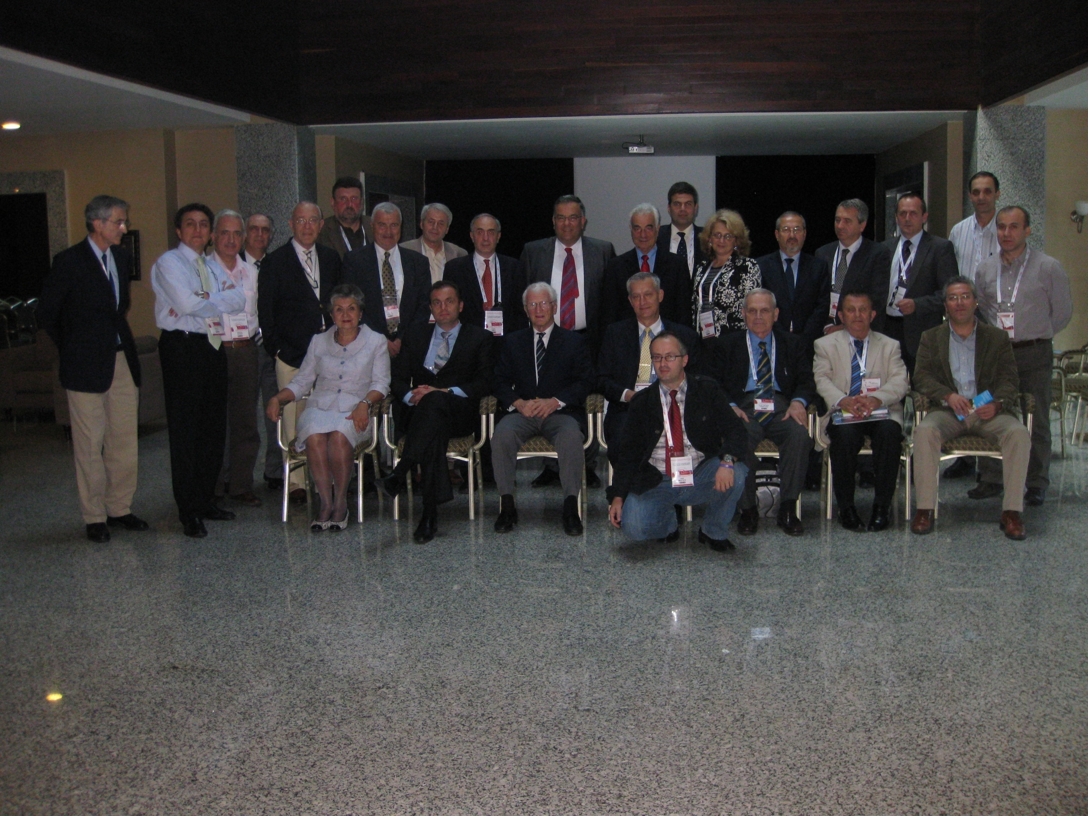
Balkan Board Meetings on ENT Education in the Balkans
at annually National Turkish ORL-HNS Congresses
since 2006 / Antalya - TURKEY

Slide 10
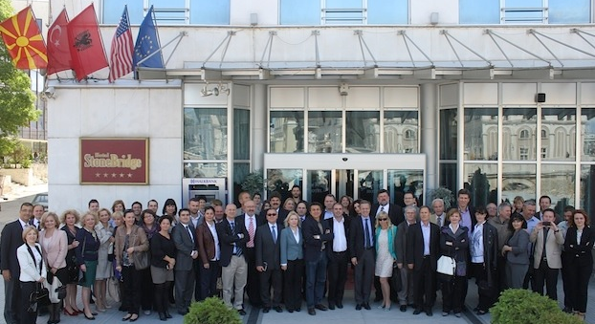
Balkan Education Tour on ORL (10-17 May 2013)
Pristine – Sarajevo – Skopje – Tirana under the auspices of Turkish Society of ORL-HNS

Slide 11
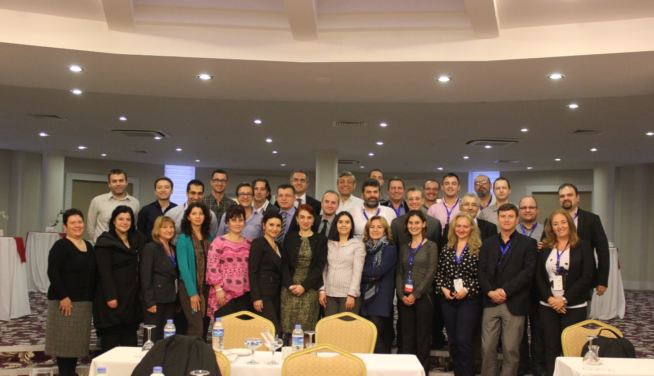
Balkan ENT Schools – Antalya since 2014

Slide 12
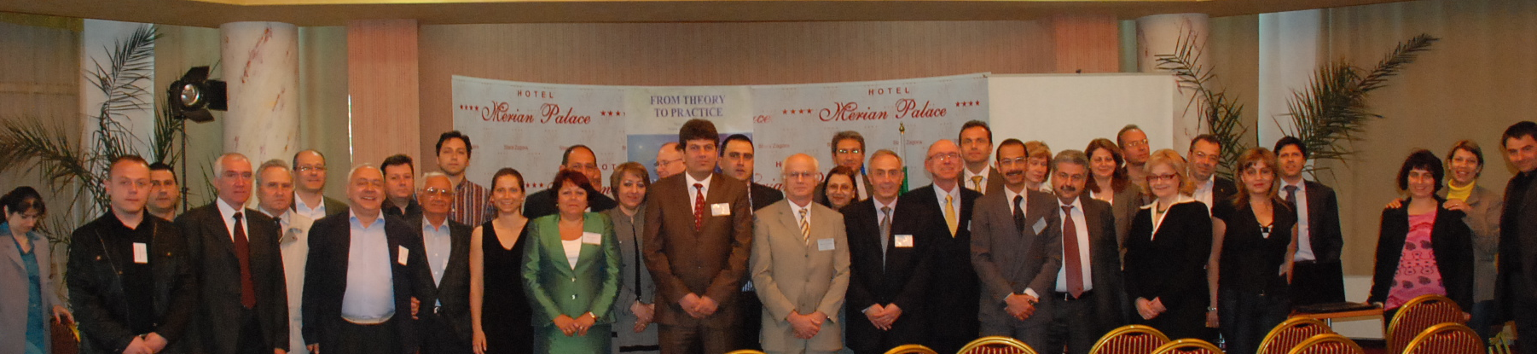
Provided platforms to meet colleagues from all Balkans
Provided current and higher knowledge
Opportunity to meet master professors and colleagues
Motivated research and education
Helped to understand the culture of the Balkans
Increased collaboration among the Balkan colleagues
Help to increase friendship in the Balkans,
Solidarity and help among us in the international arena
Improved presentation skills in English

Slide 13
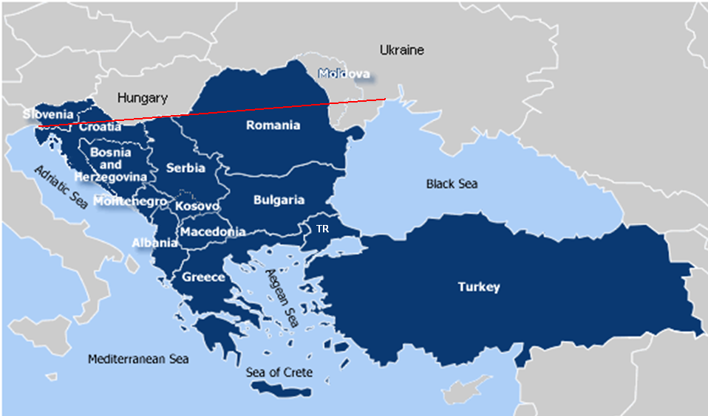
Balkan Survey of CSOM (C. Uzun)
figure revised from http://boinovski.info/wp-admin/scandinavian-peninsula-europe-map&page=2

Slide 14
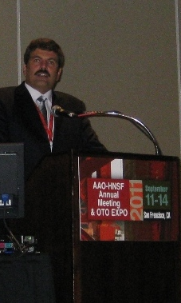
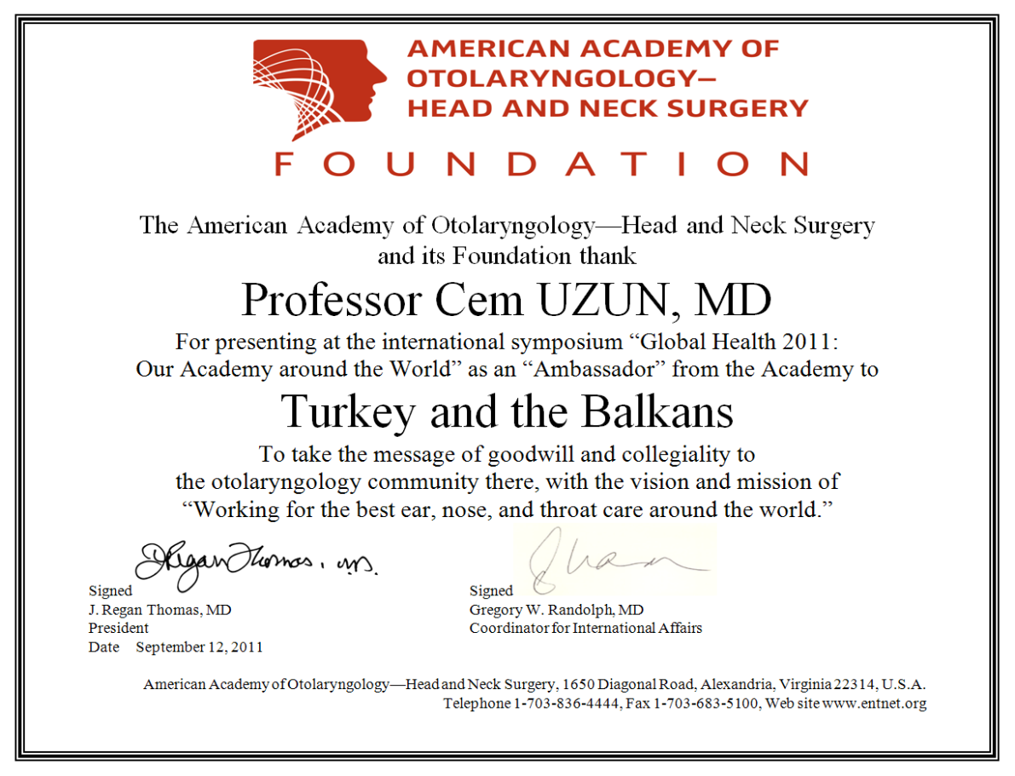

Slide 15
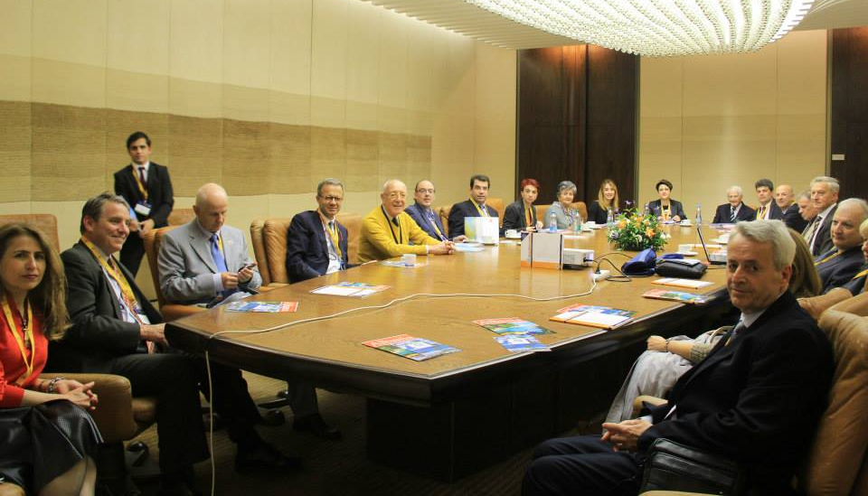
After official registraiton; Balkan Society scientific panels or courses at European Congresses or Important International Congresses (Prague, Barcelona, etc)

Slide 16
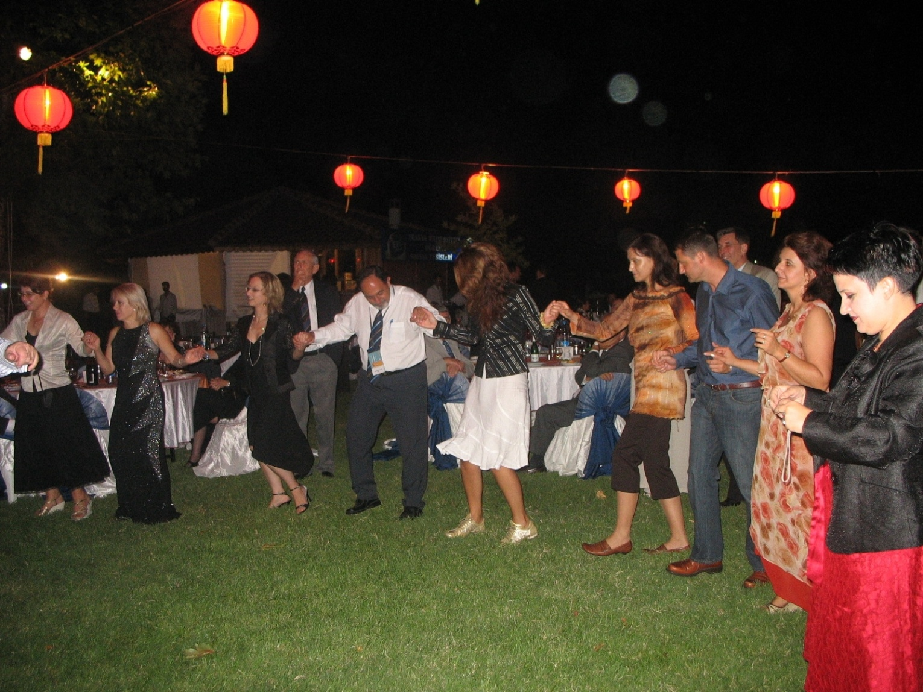
Bulgarian, Greek, Turkish, Macedonian, Serbian, Kosovan, Croatian, Albanian, … all Balkan colleagues are hand to hand
from the Balkan Congress 2006, Edirne
Dr. Cem UZUN

Slide 17
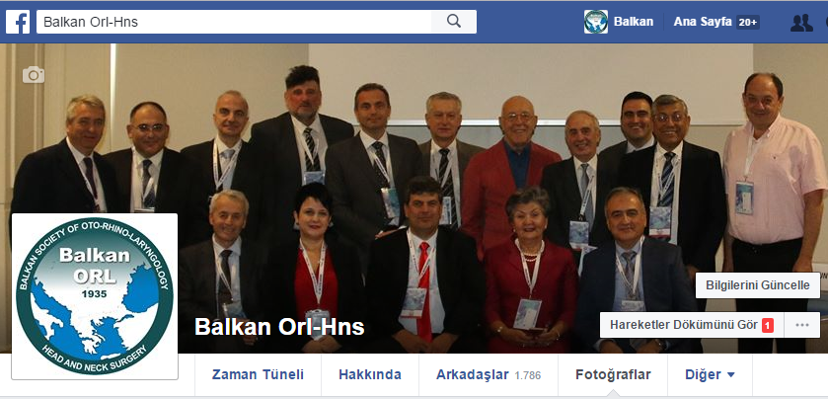
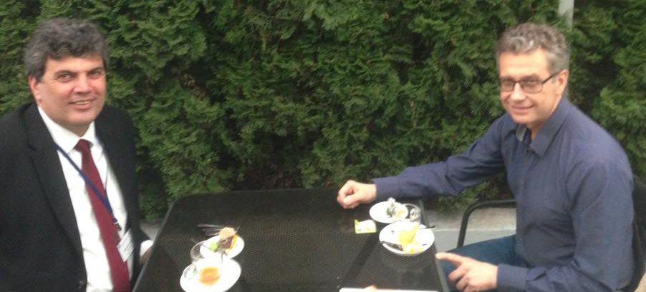
Fb: Balkan Orl-Hns
http://balkanent.org/

Slide 18
Proposals for short term planning of BUA activities
Creating meeting platforms for academicians
  Subgroups (deans) or working groups (subjects)
  Networks among academicians (e-mails)
  Annual Meetings with larger participation of academicians at working groups
New statute for official registration
  i.e.European University Association

Slide 19
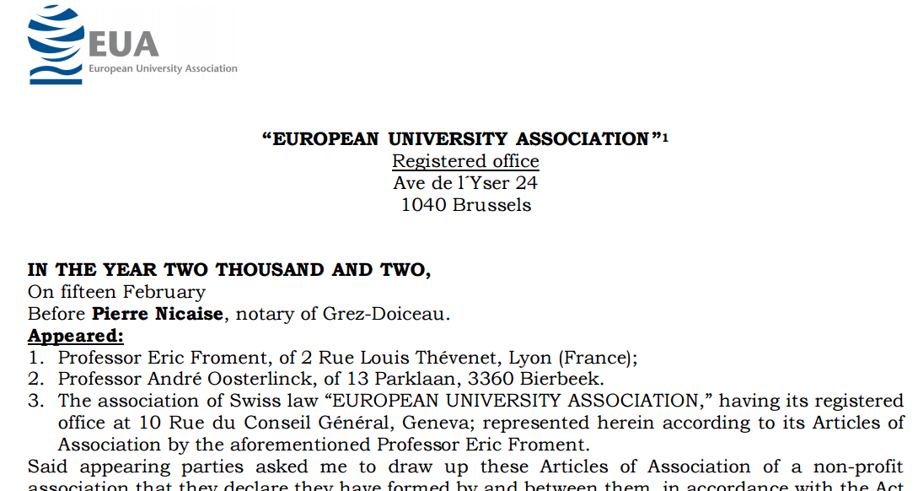
Official registration of the BUA

Slide 20
Our mid- and long-term
Recommendations
Official registration of the association
Establishment of Balkan Institutions or,
UNESCO Chairs & Networks or,
Research Centers on specific topics; i.e. on:
  History
  International Law
  Cultural and Natural Heritage
  ...

Slide 21
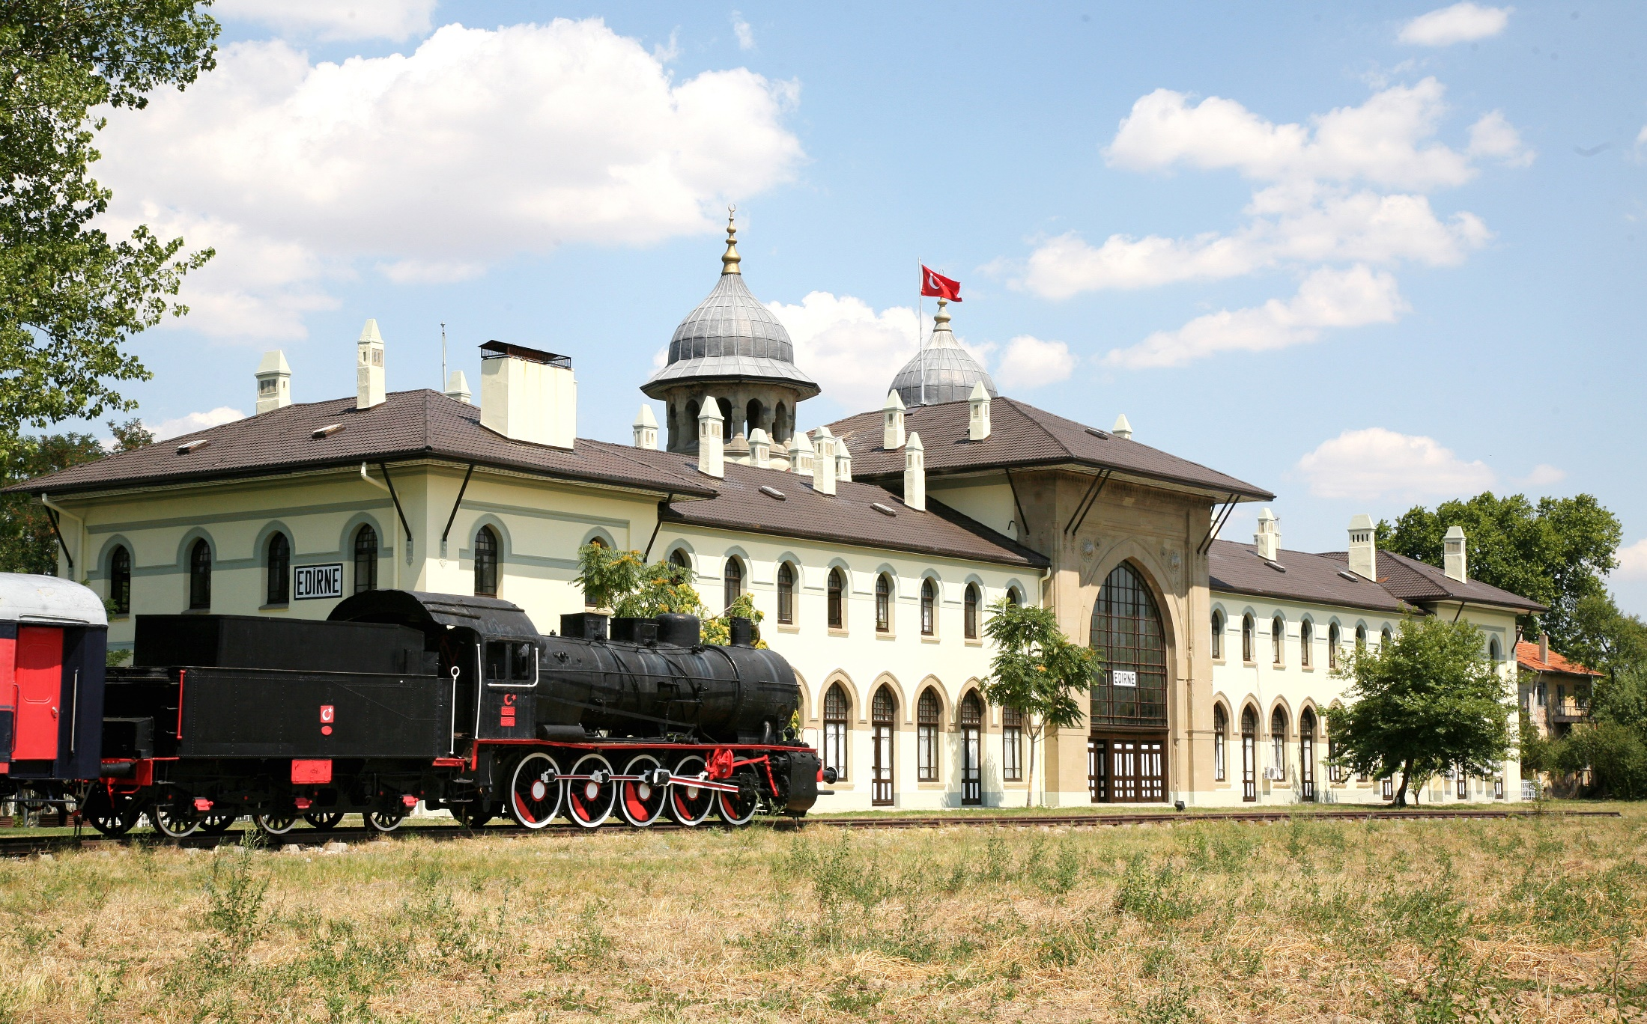
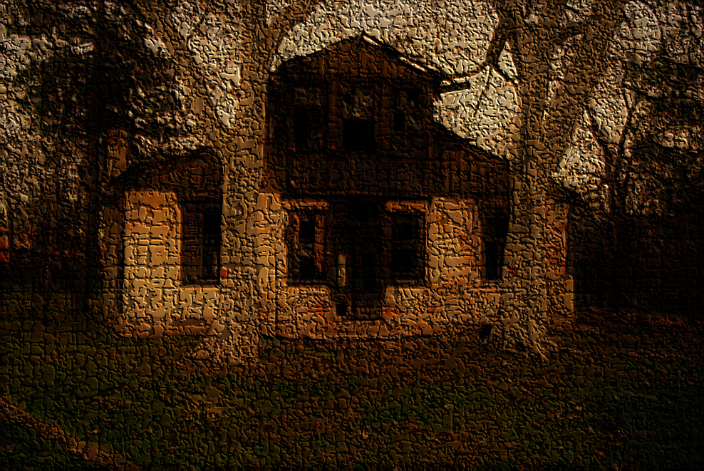
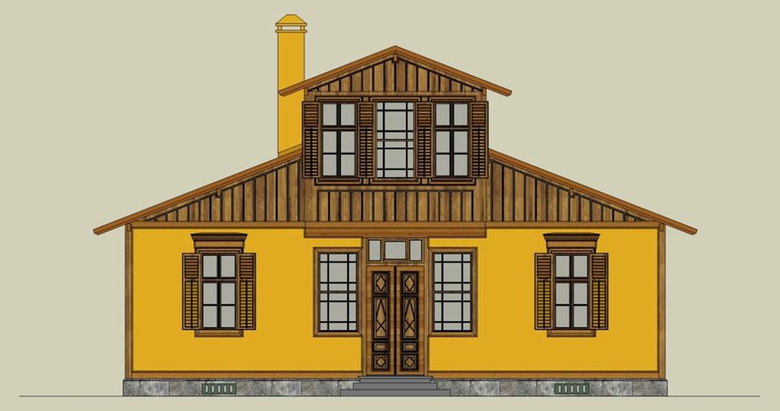

Thank you for your attention!

